Slide 1


OFDM Issues-Solutions
CNSCC.405
Digital Signal Processing
Dr Muhammad Abrar (Dr. MAB)
m.abrar@lancaster.ac.uk

Slide 2
Synchronization for OFDM
the synchronization is considered as a key factor of designing OFDM receiver.

Slide 3
Time and Frequency Error
Due to frequency-selective and time-variant property of wireless channel together with additive noise and mismatch of oscillators between transmitter and receiver, there are always time and frequency synchronization errors in a practical OFDM system.
Symbol time offset (STO)
Carrier frequency offset (CFO)
Notes:
In OFDM system, the synchronization is considered as a key factor of designing OFDM receiver. The synchronization precision significantly affects the receiver performance and usually depends on the precision of frame acquisition, symbol timing and frequency offset estimation. In contrast to single carrier modulation, OFDM has greater immunity to time synchronization error because of longer symbol duration, and is much more sensitive to frequency synchronization error due to small sub-channel bandwidth.

Slide 4
Symbol Time Offset (STO)

Slide 5
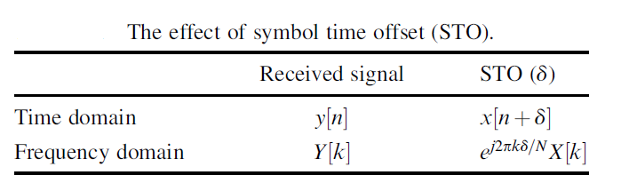
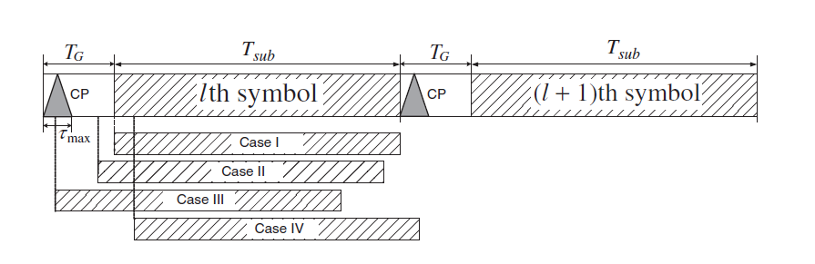
Effect of STO
IFFT and FFT are the fundamental functions required for the modulation and demodulation at the transmitter and receiver of OFDM systems, respectively
Four different cases of OFDM symbol starting point subject to STO
In the current analysis, the effects of the noise and channel are ignored
Notes:
estimated starting point is exact, a little earlier, too early, or a little later than the exact timing instance.

Slide 6
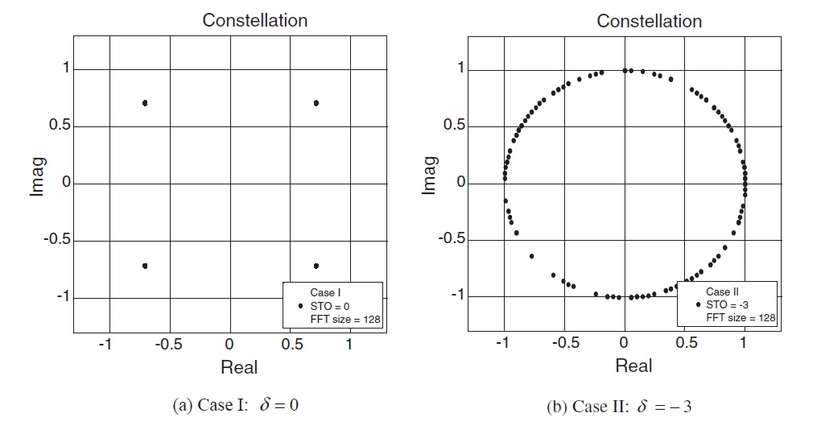
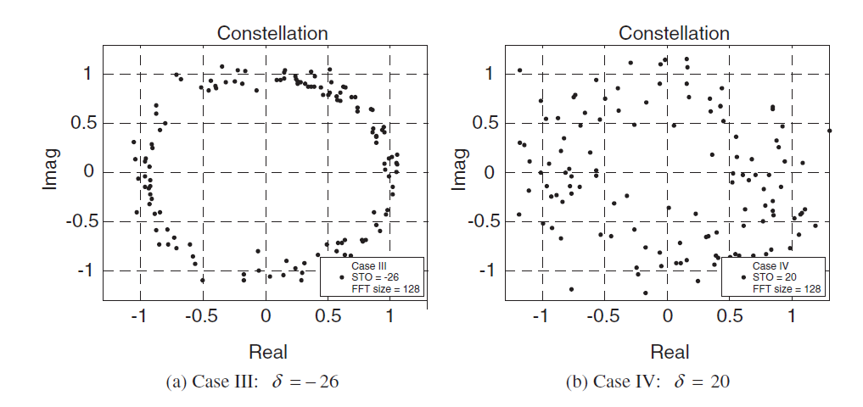
Signal constellation subject to STO

Slide 7
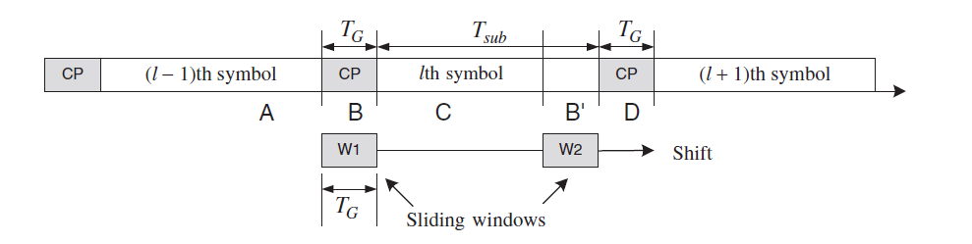
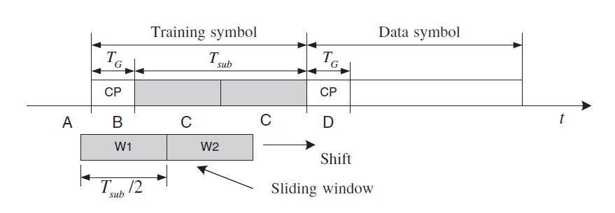
Estimation Techniques for STO
Time-Domain Estimation Techniques for STO
Using Cyclic Prefix (CP)
Using Training Symbol
STO estimation technique using double sliding windows
Correlation-based Estimation: use the cross-correlation between the
training symbol and received signal

Slide 8
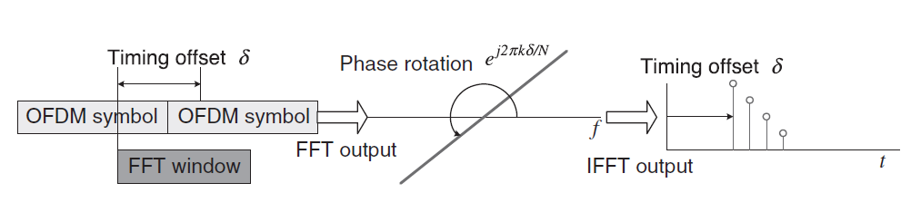
Frequency-Domain Estimation Techniques for STO
Notes:
the received signal subject to STO suffers from a phase rotation. Since the phase rotation is proportional to subcarrier frequency, the STO can be estimated
by the phase difference between adjacent subcarrier components of the received signal in the frequency domain.

Slide 9
Carrier Frequency Offset (CFO)

Slide 10
In general, there are two types of distortion associated with the carrier signal .
One is the phase noise due to the instability of carrier signal generators used at the transmitter and receiver
The other is the carrier frequency offset (CFO) caused by Doppler frequency

Slide 11
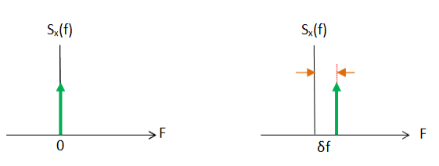
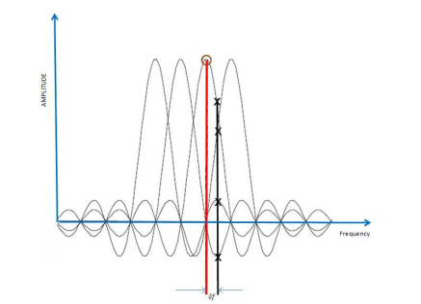



Effect of CFO
Frequency mismatched in the transmitter and the receiver oscillator;
Inter Carrier Interference (ICI);
Doppler Effect (DE).
normalized CFO, as a ratio of the CFO to
subcarrier spacing shown as

Slide 12
Doppler frequency and normalized CFO: An example.
Table presents examples of the Doppler frequency and normalized CFO at the mobile speed of 120 km/h for different commercial systems, each of which employs different carrier frequency.

Slide 13
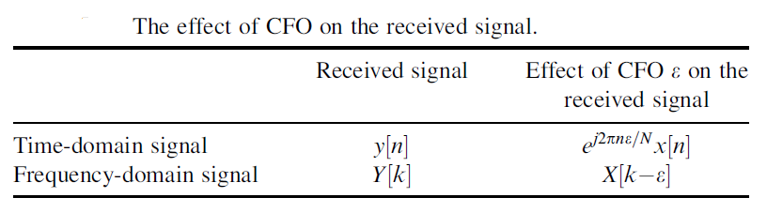
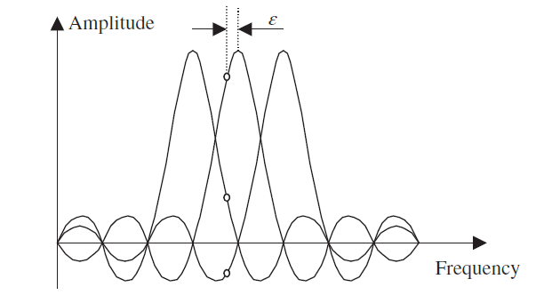
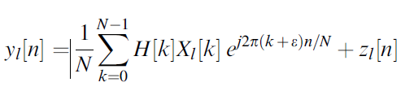
Effect of CFO
The time-domain received signal can be written as
Inter-carrier interference (ICI) subject to CFO

Slide 14
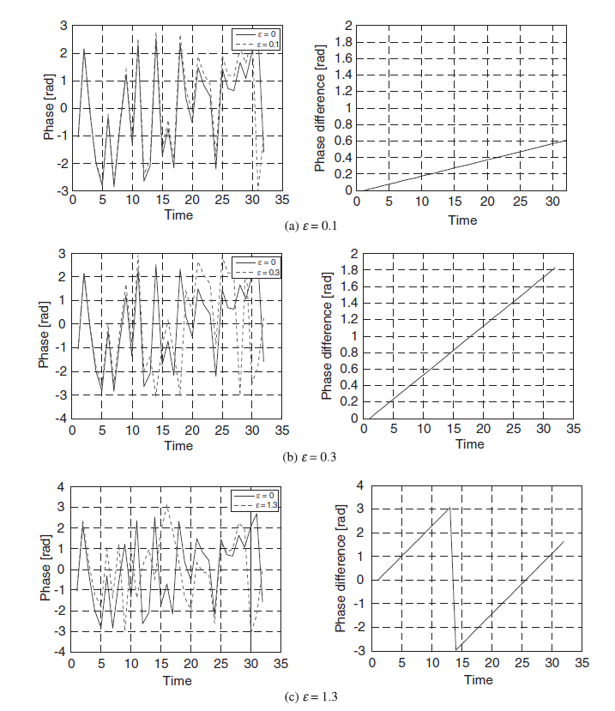
Effects of CFO on the phase of the time-domain signal.

Slide 15
Estimation Techniques for CFO
Pilot-Based Estimation

Slide 16
Estimation Techniques for CFO
Pilot-Based Estimation
Correlation-Based Estimation
Discrete Fourier Transform (DFT)-Based Estimation
Maximum Likelihood Estimation:

Slide 17
Peak-to-Average Power Ratio (PAPR)
Peak-to-Average Power Ratio (PAPR) is defined as the ratio of peak power to the average power of a signal and is expressed in decibels (dB). A lower PAPR is desired for efficient performance of a system.
The transmit signals in an OFDM system can have high peak values in the time domain since many subcarrier components are added via an IFFT operation.
Therefore, OFDM systems are known to have a high PAPR as compared with single-carrier systems.
The high PAPR is one of the most detrimental aspects in the OFDM system, as it decreases the SQNR (Signal-to-Quantization Noise Ratio) of ADC (Analog-to-Digital Converter) and DAC (Digital-to-Analog Converter) while degrading the efficiency of the power amplifier in the transmitter.

Slide 18
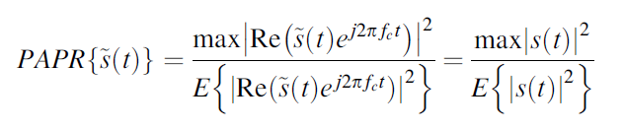

PAPR is the ratio between the maximum power and the average power of the complex passband signal s(t) , that is,
In the PSK/OFDM system with N subcarriers, the maximum power occurs when all of the subcarrier components happen to be added with identical phases.
Assuming that
PAPR = N,
that is, the maximum power equivalent to N times the average power.

Slide 19
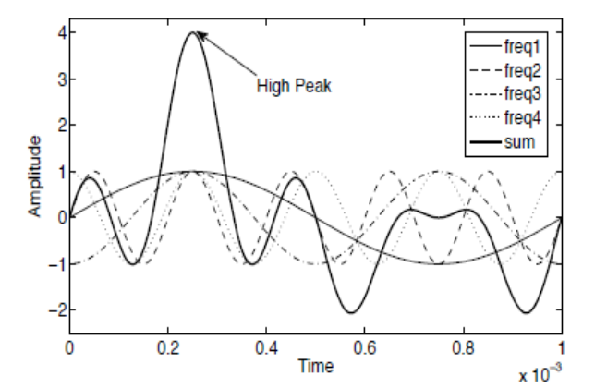

PAPR
High PAPR degrades performance of OFDM signals by forcing the analog amplifier to work in the nonlinear region, distorting this way the signal and making the amplifier to consume more power.
Decreases spectrum efficiency and energy efficiency
The most common way to evaluate the PAPR is to determine the probability that this PAPR exceeds a certain threshold . This is represented by the Complementary Cumulative Distribution Function (CCDF), which is a random variable, as:
Notes:
Figure shows how a high peak is obtained by adding four sinusoidal signals with different frequencies and phase shifts coherently. The resulting signal’s envelope exhibits high peaks when the instantaneous amplitudes of the different signals have high peaks aligned at the same time.

Slide 20
PAPR Reduction Techniques
Clipping technique
Coding technique
Probabilistic (scrambling) technique
Adaptive predistortion technique
DFT-spreading technique

Slide 21

Clipping technique
The simplest PAPR reduction method consists basically in clipping the high parts of the signal amplitude that are outside the allowed region
Advantages
simple and low-complexity
easily implemented
Disadvantages
causes in-band distortion, which degrades the performance of the BER
causes out-of-band radiation, resulting in adjacent interference.
Notes:
Clipping is the simplest non-linear and distortion-based technique that decreases the high PAPR by clipping the signal to the preset threshold. The non-linear companding is applied to the time-domain signal at the transmitter side, and a decompanding function is employed at the receiver end to determine the original OFDM signal.

Slide 22
Coding technique
The coding technique is to select such codewords that minimize or reduce the PAPR
Advantages
no distortion and creates no out-of-band radiation
easily implemented
Disadvantages
increase the computational complexity of the system
suffers from bandwidth efficiency

Slide 23
Probabilistic (scrambling) technique
This technique involves multiplying the data symbols with a random sequence before performing the inverse discrete Fourier transform (IDFT) to generate the OFDM signal. The random sequence is generated based on a probabilistic model, which helps to reduce the PAPR of the transmitted signal while maintaining the integrity of the data.
Advantages
simple and low-complexity
easily implemented
Disadvantages
Additional complexity in the receiver,
Reduce the overall signal-to-noise ratio (SNR)
Notes:
Clipping is the simplest non-linear and distortion-based technique that decreases the high PAPR by clipping the signal to the preset threshold. The non-linear companding is applied to the time-domain signal at the transmitter side, and a decompanding function is employed at the receiver end to determine the original OFDM signal.

Slide 24
Adaptive predistortion technique
This technique involves introducing a predistortion signal to the transmitted signal to counteract the effects of PAPR. The predistortion signal is adaptive and can be adjusted in real-time based on the characteristics of the transmitted signal.
Advantages
low-complexity
can be used in combination with other signal processing techniques
Disadvantages
use of a feedback loop-accuracy of the feedback
Requires careful optimization
Notes:
Clipping is the simplest non-linear and distortion-based technique that decreases the high PAPR by clipping the signal to the preset threshold. The non-linear companding is applied to the time-domain signal at the transmitter side, and a decompanding function is employed at the receiver end to determine the original OFDM signal.

Slide 25
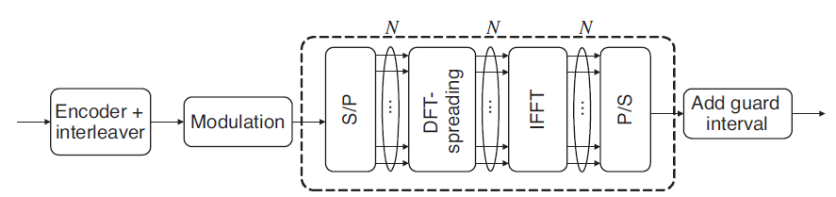
DFT-spreading technique
This technique involves spreading the data symbols over multiple subcarriers using the discrete Fourier transform (DFT). The spreading operation reduces the PAPR of the transmitted signal by redistributing the power over a larger bandwidth.
Advantages
low-complexity
can be used in combination with other signal processing techniques
improve the spectral efficiency
Disadvantages
reduce the overall data rate
Introduce some additional delay in the transmitted signal
This can reduce the PAPR of OFDM signal to the level of single-carrier transmission.
This technique is particularly useful for mobile terminals in uplink transmission
Notes:
The DFT-spreading technique is to spread the input signal with DFT, which can be subsequently taken into IFFT. This can reduce the PAPR of OFDM signal to the level of
single-carrier transmission. This technique is particularly useful for mobile terminals in uplink transmission. It is known as the Single Carrier-FDMA (SC-FDMA), which is adopted
for uplink transmission in the 3GPP LTE standard

Slide 26
Questions
What is OFDM, and how does it differ from traditional modulation schemes?
Explain the concept of subcarriers in OFDM. How are they used in transmitting data?
Why is the cyclic prefix (CP) important in OFDM systems, and how does it address the issue of inter-symbol interference?
What is the significance of the guard interval in OFDM, and how does it contribute to robust communication in the presence of multipath propagation?
How does OFDM handle frequency-selective fading in wireless channels?
Explain the role of pilot symbols in OFDM. Why are they inserted into the transmitted signal?

Slide 27
Questions
What is the Synchronization Timing Offset (STO) in OFDM, and why is accurate synchronization crucial for successful data reception?
How does frequency offset affect the performance of an OFDM system, and what techniques are employed to mitigate this issue?
Discuss the impact of channel impairments, such as noise and interference, on the performance of OFDM systems.
Explain the concept of Peak-to-Average Power Ratio (PAPR) in OFDM. Why is it a concern, and what techniques can be used to reduce PAPR?
Describe the trade-offs between time-domain and frequency-domain synchronization techniques in OFDM systems.
How does OFDM support multiple access in the context of multiple users sharing the same frequency band?

